Slide 1
Indonesia’s Business Environment

Slide 2
Introduction of Indonesia
The GDP is estimated at US $1.074 trillion
Per capita of US $4116.
Mixed economy with both private and public sectors
The biggest economy in the Southeast Asia and a member of the G20
The population living below the poverty line accounts for 10.8%
Unemployment rate is at 5.5%.
(Wati, 2018)
Notes:
The GDP of Indonesia is estimated at US $1.074 trillion with a per capita of US $4116. The country has a mixed economy containing both the private sector and the government taking vital roles in its growth. The biggest economy in the Southeast Asia and is a member of the G20 and the 16th largest economy by nominal GDP. The population living below the poverty line accounts for 10.8% and the unemployment rate is at 5.5%. The country has well developed infrastructure which makes it vital for economic integration.

Slide 3
Business opportunities in Indonesia
Services sector largest ; 43.3% of the national GDP
Manufacturing sector ; 42.9 percent is second.
Automobile industry ranks at number 18 worldwide
Produced 12 billion packs last year.
Energy sector
Notes:
Services sector is the largest representing 43.3% of the national GDP followed by manufacturing sector that has 42.9 percent by 2016. Automobile industry in Indonesia ranks at number 18 worldwide with production of 12 billion packs last year. Energy sector are among the sectors with business opportunities in the country as it produces 2.5 p0ercent of the global natural gas.

Slide 4
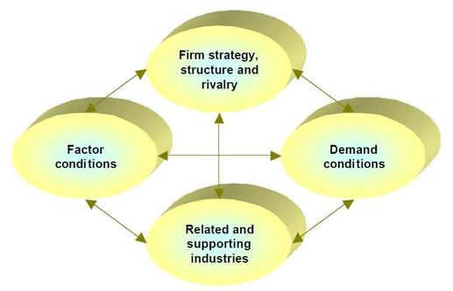
Porter’s Diamond of National Advantage
(Porter, 2011)

Slide 5
Factor conditions
127 million labor force, efficient for the production
Advancing infrastructure
Favorable political and economic conditions
Advancement in R&D
Plentiful natural resources
Notes:
Depending on the type of business a company is yet to carry in Indonesia, there various factors that make it a suitable country for trade. Factors such as labor force, is considered to be very efficient for the production since the workforce is at 127 million with 50 percent being in the formal industry. Infrastructure in the country has been advancing and this makes it possible for the business of various industries to move on smoothly. The political and economic conditions of the country are favorable for businesses in the country and there is great confidence by citizens on the government. Additionally, there are several overseas businesses in the country due to the advancement in the science and technology in the country that has allowed R&D. on the firms that dwell on the shrimp business for example, the country has a plentiful natural resources that allow easy expansion of their business into the country.

Slide 6
Context for firm strategy, structure and competition
Better firm strategy in several industries.
A well developing technology.
Free entry and exit into industries makes it highly competitive.
High capital investment.
(Wati, 2018)
Notes:
Being an economy that is developing very fast, the Indonesia has better firm strategy in several industries. Though the country is not so much into technology but the overall basis is that they are developing well their technology. Free entry and exit into industries such as construction makes it highly competitive. The increased competition makes the industry more perfect for export and entrance of new firms. As a result there is high capital investment.

Slide 7
Demand conditions
Increasing per capita consumption
Growing middle income class
Controlled and stable inflation at 3 percent
Growing purchasing power.
Dynamic and open society for global market.
(Budiwibowo et al., 2009)
Notes:
With the increasing per capita consumption on various goods in the country, there is opportunity for business since the demand for goods has also been on the rise since the middle income class is also growing. There is a controlled and stable inflation at 3 percent in the past three years. With the 127 million people in the workforce, there has been a growing purchasing power. In fact, Indonesia is a dynamic and open society for global market.

Slide 8
Related and Supporting Industries
There are many related industries
Inadequate supporting industries creating low competition.
lack of related industries in some businesses
Notes:
There are many related industries in Indonesia that are complete and help each other in the business to ensure there is enough supply to the consumers. The supporting industries in some businesses are considered inadequate creating low competition in those industries. In industries like shrimp, there has been lack of related industries hence they use exports

Slide 9
Culture and Environment
Indonesia is a multilingual,
Multicultural and a multiethnic
Multitude of religions.
Favorable business policies
Open to innovation and technologies.
Culture focuses on development of industries.
Notes:
Indonesia is a multilingual, multicultural and a multiethnic country that are influenced by multitude of religions. There are favorable policies that support environmental conservation and a good business environment that is open to innovation and technologies. The culture also focuses on development of industries.

Slide 10
Benefits
Existence of several natural resources
Great possibility in market of 250 million residents
Great purchasing ability.
Notes:
Existence of several natural resources that have high potential of being developed. Great possibility in market of 250 million residents in Indonesia with great purchasing ability. Supporting of infrastructure development by the US in the country is a great benefit to the country. Additionally, there is an increasing demand as supportable market segments with an unsaturated market.

Slide 11
Benefits
Supporting of infrastructural development by the US
Increasing demand due to supportable market segments
Unsaturated market.

Slide 12
Issues
High competition
There is a low score in infrastructure
The inadequacy in the supporting industries
Notes:
There exists high competition in these sectors as there are several industries that need to serve the consumers as a company must go an extra mile to gain a competitive advantage. There is a low score in infrastructure that has dragged the expansion of some industries. The inadequacy in the supporting industries creates low competition in the markets.

Slide 13
Compatibility
Cultural compatibility creates a good business environment.
Suitable business environment
Favorable business conditions
Notes:
Compatibility is important for any international firm and considering cultural compatibility creates a good business environment. The business environment is suitable right from political to technological environment. Theses offer favorable business conditions.

Slide 14
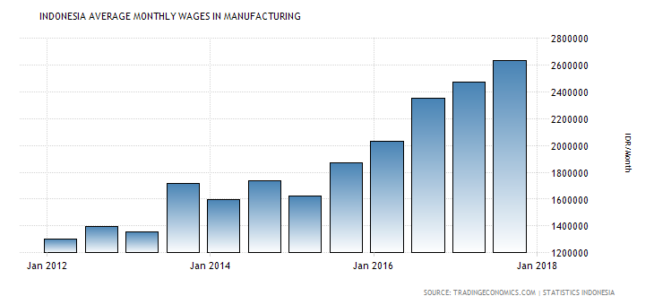
Cost and labor
Good organization and labor laws
Different states have different minimum wages
There is a rising salary increment
Lack of cheap labor in the industry.
Labor ethics are not up to standard
Notes:
There is a good organization and labor laws that guide employment of individuals. Different states have different minimum wages Jakarta for instance pays a minimum wage of US $252. There is a rising salary increment meaning that there is no cheap labor in the industry. The labor qualities in the country depend on the previous experiences and skills, and networking though the labor ethics are not up to standard but there has been a great improvement.

Slide 15
Conclusion
In general, Indonesia is becoming a top country among the Bric and Mitsk countries to invest in due to:
Large population with a growing per capita income
Well-developed labor laws
Low rate of unemployment
Better workforce with standard work ethics
Notes:
In general, Indonesia is becoming a top country among the Bric and Mitsk countries to invest in. from a large population with a growing per capita income to well-developed labor laws that has a low rate of unemployment, Indonesia workforce has better standard of work ethics than most countries.

Slide 16
references
Budiwibowo, A., Trigunarsyah, B., Abidin, I. S., & Soeparto, H. G. (2009). Competitiveness of the Indonesian construction industry. Journal of Construction in developing countries, 14(1), 51-68.
Porter, M. E. (2011). Competitive advantage of nations: creating and sustaining superior performance (Vol. 2). Simon and Schuster.
Wati, L. A. (2018, April). Analyzing the development of Indonesia shrimp industry. In IOP Conference Series: Earth and Environmental Science (Vol. 137, No. 1, p. 012101). IOP Publishing.
Workman, D. (2017). World's top exports. Obtenido de World's top exports: http://www. worldstopexports. com/bananas-exports-country.

